Slide 1
Stream Availability
Nod BC#4 2022

Slide 2
What is it?
Search for movies or series and check which streaming services have them
60 countries
20 streaming services

Slide 3
How does it work?
API
Define if it is a movie or series
Enter a keyword
Displays the results in an easy-to-read table

Slide 4
Challenges
Data cleaning
A lot hidden in the same column
And a lot of unnecessary information
Get all the data
Could only search one country and one service at a time
API request limit
Only 100/day

Slide 5
Highlights
When the API worked
Got the right info from the original DF
First MVP

Slide 6
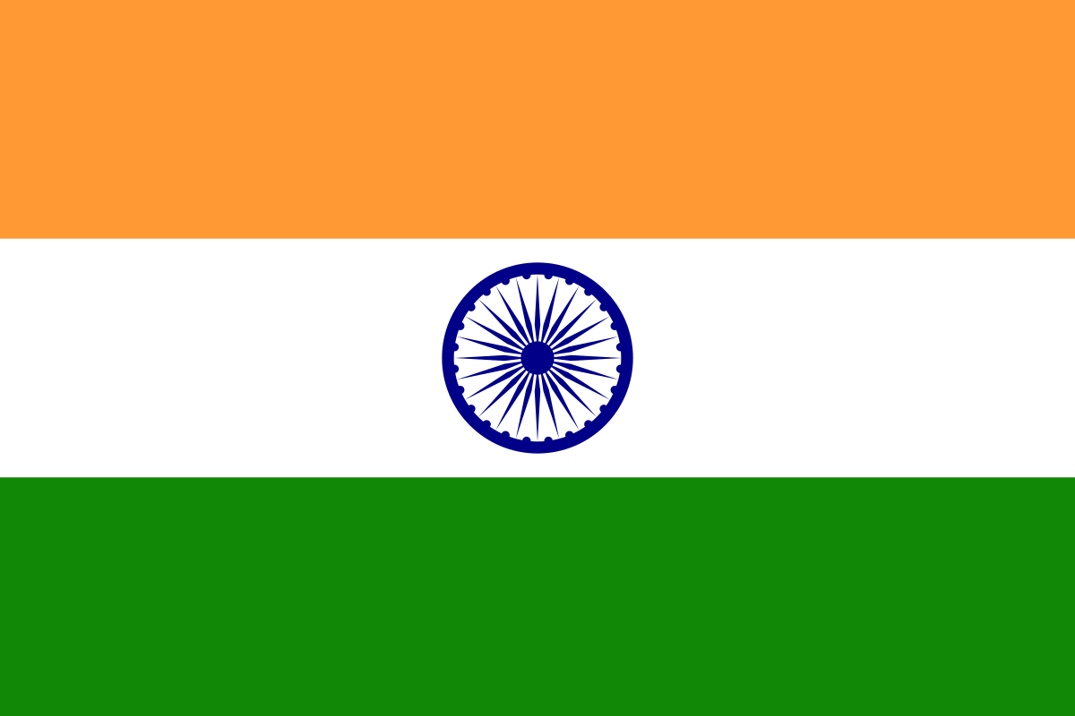




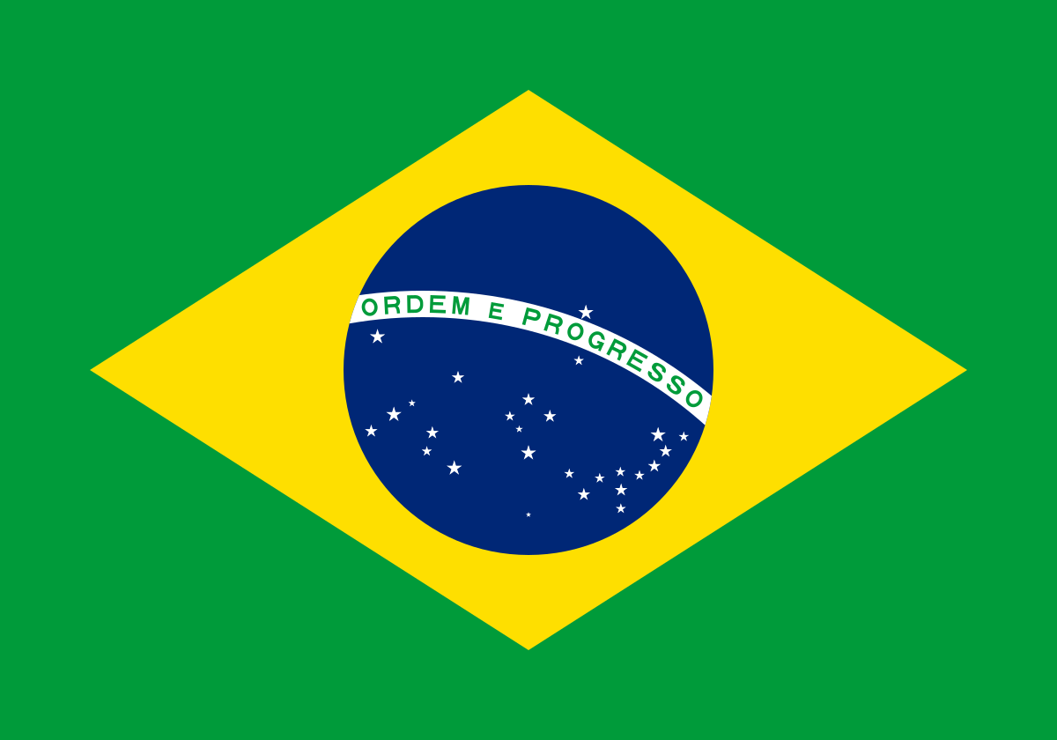



Let's test it
Limitations due to API limits
Only 5 countries (Sweden, Great Britain, Brazil, Croatia, India)
Only 4 streaming services (Netflix, Prime, HBO Max, Disney)

